Slide 1
Sensors

Slide 2
Sensors
We’ll discuss sensors for:
Light
Heat
Sound
Distance
Touch/pressure
Displacement/angle
Location/heading
Movement
Acceleration
Chemicals/scents

Slide 3
Light energy
For a sensor, we’re interested in the light power that falls on a unit area, and how well the sensor converts that into a signal.
A common unit is the lux which measures apparent brightness (power multiplied by the human eye’s sensitivity).
Lux (symbol lx) is the SI unit for illuminance and luminous emittance (Measuring Luminous Flux per unit area).
1 lux of yellow light is about 0.0015 W/m².
1 lux of green light (50% eff.) is 0.0029 W/m².
Sunlight corresponds to about 50,000 lux
Artificial light typically 500-1000 lux

Slide 4
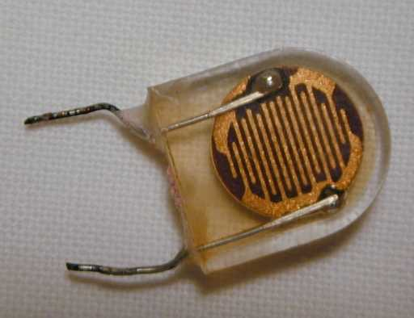
Light sensors
Simplest light sensor is an LDR (Light-Dependent Resistor).
Optical characteristics close to human eye.
Can be used to feed an A/D directly without amplification (one resistor in a voltage divider).
Common material is CdS (Cadmium Sulphide)
Sensitivity: dark 1 MΩ, 10 lux 40 kΩ, 1000 lux 400 Ω.

Slide 5
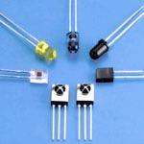
Light sensors
Semiconductor light sensors include: photodiodes, phototransistors, photodarlingtons.
All of these have similar noise performance, but phototransistors and darlingtons have better sensitivity (more current for given light input).
Phototransistor: 1 mA @ 1000 lux
Photodarlingtons up to 100x this sensitivity.
Notes:
Photodarlingtons are darlingting transistors which are bipolar transistor pairs connected in such a way that the current amplified by one is fed into the other and amplified by that also giving overall high amplification.

Slide 6
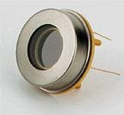
Light sensors – high end
At the cutting edge of light sensor sensitivity are Avalanche (breakdown) photodiodes.
Large voltages applied to these diodes accelerate electrons to “collide” with the semiconductor lattice, creating more charges.
These devices have quantum efficiencies around 90% and extremely low noise.
They are now made with large collection areas and known as LAAPDs (Large- Area Avalanche Photo-Diode)

Slide 7
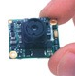
Light sensors – cameras
Two solid-state camera types: CCD and CMOS.
Charge Coupled Device (CCD) is an integrated circuit etched onto a silicon surface forming light sensitive elements called pixels.
CCD is the more mature technology, and has the widest performance range.
8 Mpixel size for cameras
Low noise/ high efficiency for astronomy etc.
Good sensitivity (low as 0.0003 lux, starlight)
CCDs require several chips, but are still cheap ($50 +)
Most CCDs work in near infrared and can be used for night vision if an IR light source is used.

Slide 8
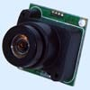
Light sensors – cameras
CMOS cameras are very compact and inexpensive, but haven’t matched CCDs in most performance dimensions.
Start from $20(!)
Custom CMOS cameras integrate image processing right on the camera.
Allow special functions like motion detection, recognition.

Slide 9
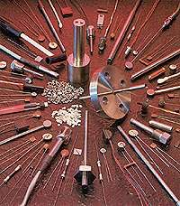
Temperature/Heat sensors
Many devices can measure temperature. Basic heat sensors are called “thermistors” (heat-sensitive resistors).
Available in a very wide range of resistances, with positive or negative resistance change/temp.
1-wire device family includes a thermometer.

Slide 10
Heat vision
Heat can be “seen” at a distance. Recall temperature = heat/atom. At room temp each atom has average energy 6.3 x 10⁻²¹ J (lecture 10).
Some of this energy is emitted as photons.
A photon of energy E and frequency f satisfies: E = h f where h is Planck’s constant = 6.63 x 10⁻³⁴ J sec
Thermal photons have frequency ~ 10¹³ Hz and wavelength ~ 30 μm
This is in the far infrared range. Sensors that respond to those wavelengths can “see” warm objects without other illumination.

Slide 11
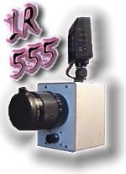
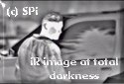
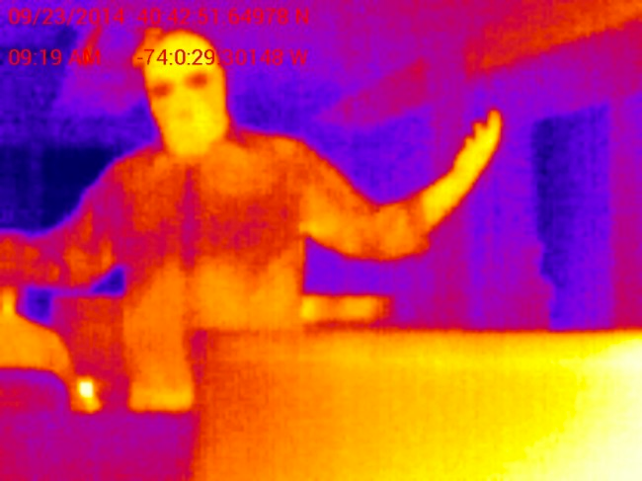
Thermal imagers
Far infrared CCD cameras exist for 10 μm and above, but are much more sophisticated (and expensive) than near-infrared CCDs.
Generally many $1000s

Slide 12
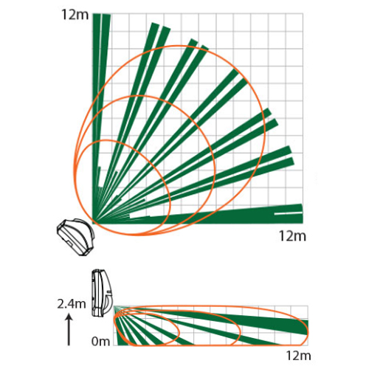
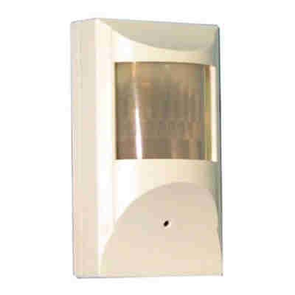
Thermal sensors
PIR (Pyroelectric/Passive InfraRed) sensors can detect IR heat radiation (7-20 μm typical).
They are simple, cheap and common. The basis of security system “motion detectors”.
Most PIR sensors contain two or four sensors with different viewing regions.
They detect a change in the difference between the signals and give a binary output.

Slide 13
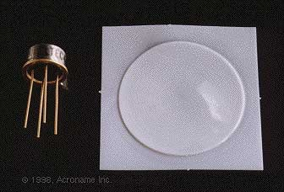
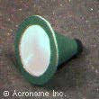
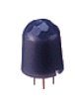
Thermal sensors
A few component PIR sensors are available that provide the PIR analog signals directly.
Eltec two-element sensor, shown with matching fresnel IR lens and mounting:
NAIS ultra-compact PIR sensor
Note: PIR sensors are slow with time constants ~ 1 sec
Notes:
Fresnel (Pronounced: Frenor or Fi - no-r) is a flat lens made of a number of concentric rings, to reduce spherical aberration)

Slide 14
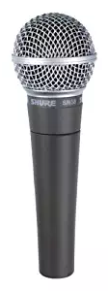
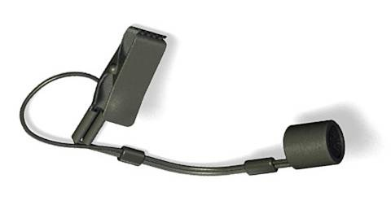
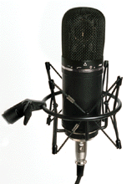
Sound sensing
Microphone types:
Dynamic (magnetic), high-quality, size, cost
Piezoelectric, small, cheap, fair quality
Condenser, good quality, cheap, small
Condenser mikes are the most common, and range from low-end to top-end in performance.

Slide 15
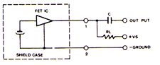
Sound sensing
Most condenser mikes include a built-in amplifier, and must be connected to a voltage supply through a resistor.
Almost any microphone will need further amplification before being fed to an A/D. Many audio preamp ICs can be used for this.

Slide 16
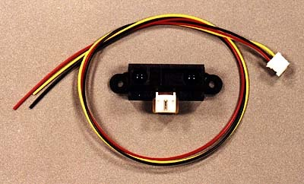
Distance sensors
Many kinds. At the low end, IR range sensors (Sharp sensor example).
An LED transmits (modulated) light, a phototransistor detects the strength of the modulated return signal. Good to a few ft.

Slide 17
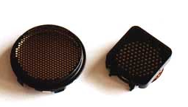
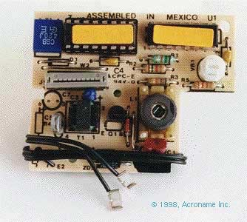
Distance sensors
Sonar sensors. Polaroid sells several sonar modules that are very popular in mobile robot applications. Several pulses per second.
Can measure range up to 30 inches or more.

Slide 18
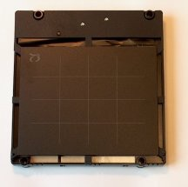
Touch sensors
We have several overlay touch screens (< $100) for laptop screens.
Tactex makes high-performance touch surfaces:
They respond to multiple finger contacts, 8000 samples/sec.
Intended for digital music input, and other expressive interactions.

Slide 19
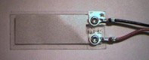
Touch sensors
Piezoelectric film creates voltages in response to strain. It can be cut to custom shapes for special-purpose sensors.
Sensors include accelerometers, bend sensors, hydrophones,…
MSI (Measurement Specialists Inc.) sells a variety of piezo film products.

Slide 20
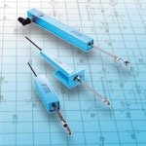
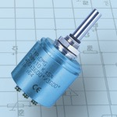
Displacement/Angle Sensors
A very simple way to measure displacement or angle is to use a potentiometer as a voltage divider with output to an A/D converter.
Precision potentiometers come in both linear and multi-rotation angular types.

Slide 21
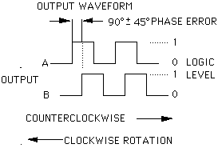

Displacement/Angle Sensors
Encoders measure relative displacement.
A pattern of light-dark bars is attached to the moving element.
Light sensors observe each region.
The number of transitions encodes the movement in either direction.
B
A

Slide 22
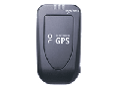
Location/Direction
GPS provides location in LAT/LONG coords.
Standard NAVSTAR systems good to ~ 5m.
Survey grade GPS accurate to a few inches.
Location calibration points may push consumer accuracy toward the latter figure.
Bluetooth GPS modules now ~ $200.
Cost increment for GPS in CDMA cell phones ~ $5
Notes:
NAVSTAR is a network of U.S. satellites that provide global positioning system (GPS) services
A satellite navigation system with global coverage may be termed a global navigation satellite system (GNSS).
E.g. United States NAVSTAR Global Positioning System (GPS), Russian GLONASS and the European Union's Galileo.

Slide 23
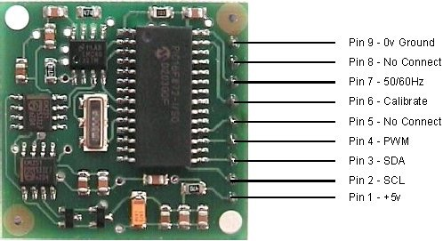
Location/Direction
Small magnetic compasses are available, such as the trekker ($65 kit):
Can be tricky to use magnetic compass data indoors, but may have good luck with it in non-metallic robots.

Slide 24
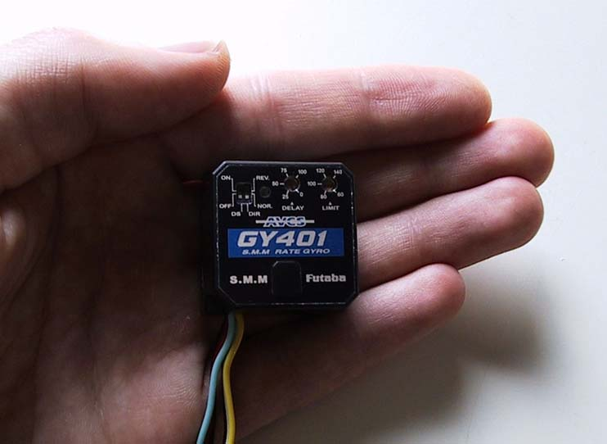
Location/Direction
Gyroscopes maintain direction information with fast response time.
Small gyros were developed for model helicopter use. 270 Hz update.

Slide 25
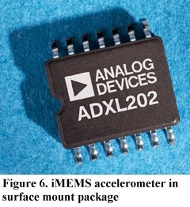
Acceleration
Accelerometers are based either on MEMs or piezo-electric components.
Analog devices ADXL-series is a good example: ADXL202
2-axis
2 mg resolution, 60 Hz
6 kHz sensing range
~ $20 and dropping.

